Slide 1
Customer Churn Detection
Our Bank – Australia Retail Bank
Ovais Khan

Slide 2
AGENDA
01
02
03
04
Project Background
Client Introduction and Problem Statement
Business Problem Definition
Business question v.s. Data questions
Project Process & Approach
How work process
Values delivery
EDA, Modelling, & Testing
Next steps and Summary
05
Future improvements

Slide 3
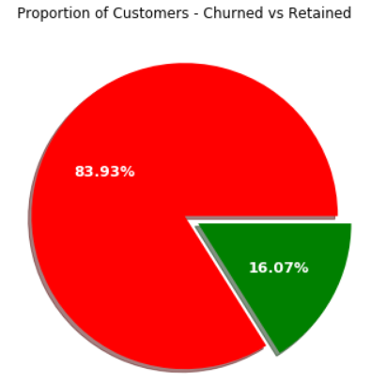
Project Brief
Client Introduction & Problem Statement
Credit Cards Department of OurBank - Australian retail bank with the largest branch and ATM networks.
OurBank offers four types of credit cards.
Blue,
Silver,
Gold,
Platinum
Management team is concerned with Customers attrition

Slide 4
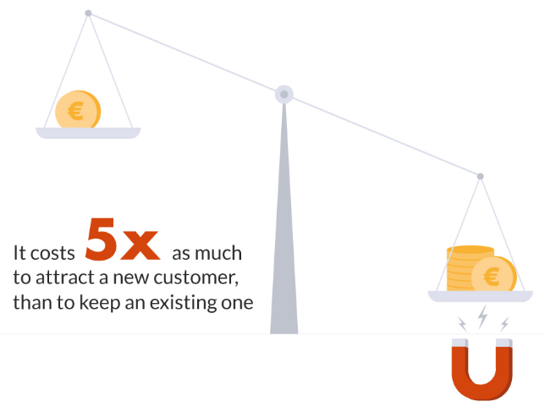
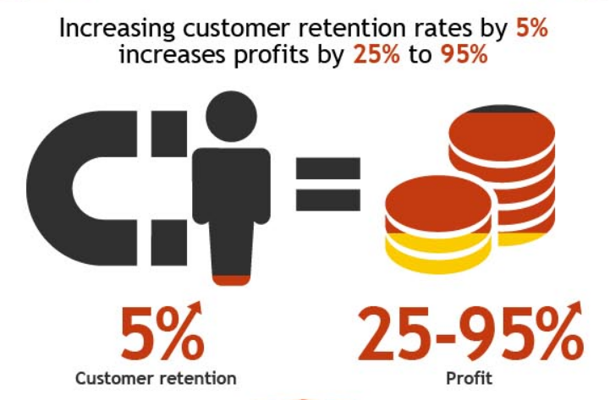
Financial Impacts Retain Existing vs Getting New
Major Australian Bank:
Income: $9,634M; Customers: 17M
10% - 15% - Revenue loss due to Churn
1 in 6 Adults Churn
Retention key as Key as new Business 0% - 4%, client acquisition is expensive.
Retention Management:
Advanced Analytics and Predictive Indicators, identify red flags, early enough 3 Months – 6 Months
Can reduce attrition by 20% - 30%, that could double revenue impact @ a cost of 1% - 2%
Unusual Volume Patterns or trends; Service Errors,

Slide 5
AGENDA
01
02
03
04
Project Background
Client Introduction and Problem Statement
Business Problem Definition
Business question v.s. Data questions
Project Process & Approach
How work process
Values delivery
EDA, Modelling, & Testing
Next steps and Summary
05
Future improvements

Slide 6
一Business Question
“ Can we identify. with reasonable certainity the customers who are liklely to churn??? ”
“ What model could be used to predict which has the best accuracy.
Also what are some of the most important factors for that model”
一Data Question

Slide 7
AGENDA
01
02
03
04
Project Background
Client Introduction and Problem Statement
Business Problem Definition
Business question v.s. Data questions
Project Process & Approach
How work process
Values delivery
EDA, Modelling, & Testing
Next steps and Summary
05
Future improvements

Slide 8
Approach to Solving the problem
Understanding the Data
Data Cleaning and General or Summarized EDA on overall dataset.
Detailed EDA
Machine Learning Model
Detailed EDA on each factor individually and its relation to churn. For e.g. which card category had more churn, or which income level had more churn
Prepare data for ML and run Linear and Non Linear ML Models to predict customers at risk of churn.
Model Evaluation
Evaluate and improve model score if required and understand the factors / features that contribute most to the score.
Dashboard to track the important parameters
Recommendations, Insights and Visualizations.
Recommend strategies that can retain customers and provide insights into why they leave.
Define a dashboard to track the metrics and important features.

Slide 9
AGENDA
01
02
03
04
Project Background
Client Introduction and Problem Statement
Business Problem Definition
Business question v.s. Data questions
Project Process & Approach
How work process
Values delivery
EDA, Modelling, & Testing
Next steps and Summary
05
Future improvements

Slide 10
Exploratory Data Analysis
Data Extraction and Cleaning:
Some outliers, but none of them incorrect entries.
Data primarily on Customer Demographics, Bank Relationship and Utilization.
Quick EDA Facts:
Overall churn 16%. Female contribution 57%
Customers who churned had more contacts on average
Higher Education level, Higher Churn

Slide 11
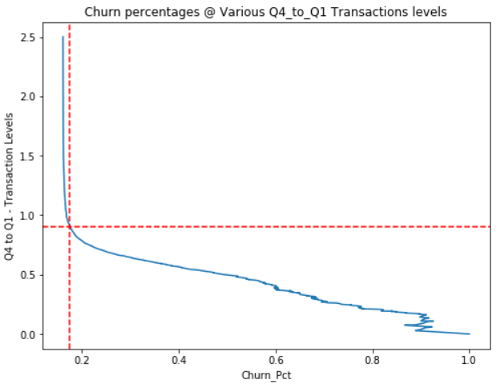
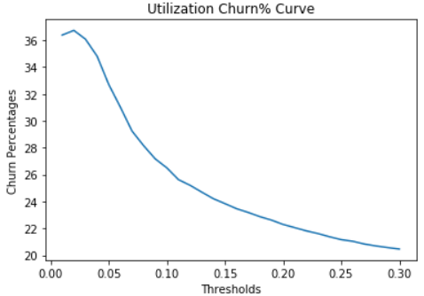
Utilization- Indicators
Outliers (1.5 – IQR) – Q4/Q1 Transaction
Avg Utilization
Retained: >= 0.30; Churned: <= 0.16
Retained: >= 77.08% Churned: <= 22.92%
As Ratio falls below 0.9; Churn increases rapidly.
Higher Likelihood, Low Threshold, More Work.

Slide 12
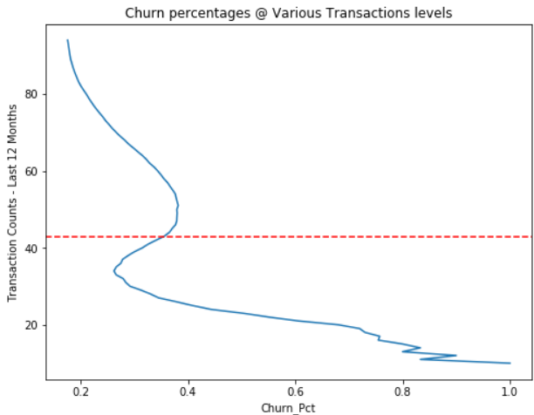
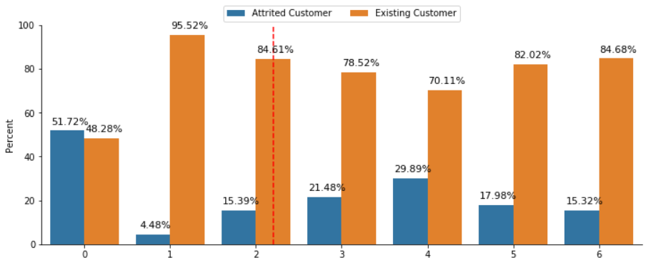
Utilization- Indicators Model Building and Evaluation Metrics
Transaction Count Last 12 Months - Medians
Months Inactive –
Retained: = 71 Churned: = 43
Retained: <= 2.2 Months Churned: >= 2.7 Months
So 40 Transactions in 12 months, or 3 – 4 Transactions / Month

Slide 13
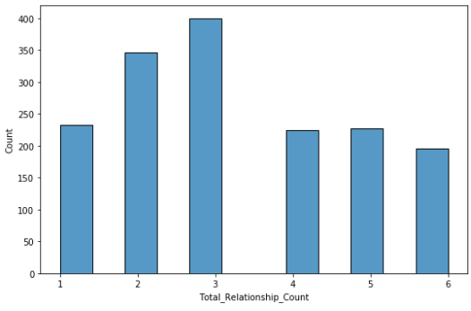
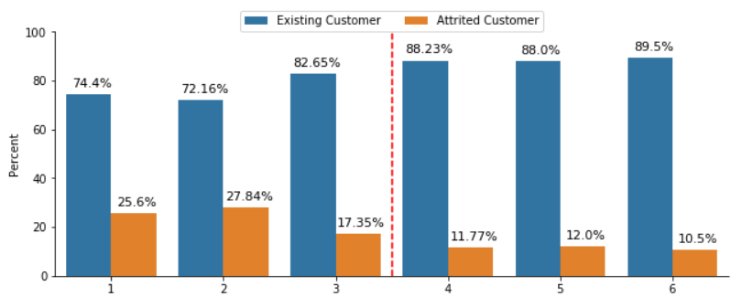
Issues with Customer Services?
Mean Products –
Retained: >= 4
Churned: <= 3
3 product had the most # of churns, might elude to bank struggling with supporting these customers.

Slide 14
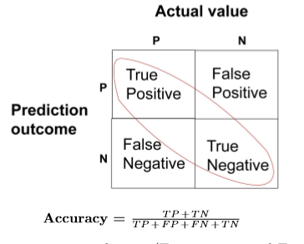
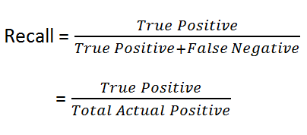
Model Building and Evaluation Metrics
ML Models:
Linear – Logistic Regression, SVM.
Non-Linear – Decision Trees, Random Forest.
Boosting Algorithms – XGBoost, CatBoost
Data Pre-Processing:
Data Encoding
Balancing categories using SMOTEENN
Evaluation Metrics:
Accuracy
Recall

Slide 15
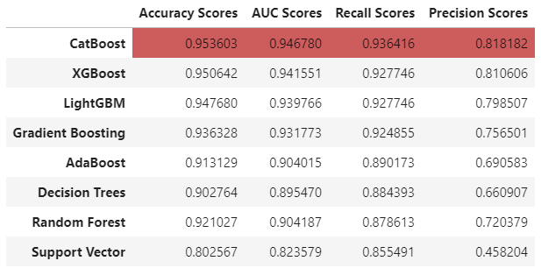
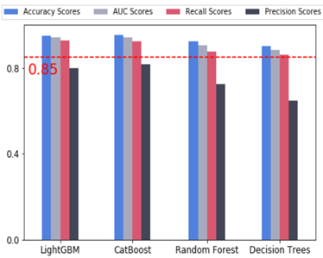
Predictive Modelling using ML Classification Algorithms

Slide 16
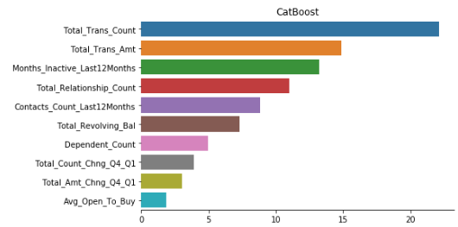
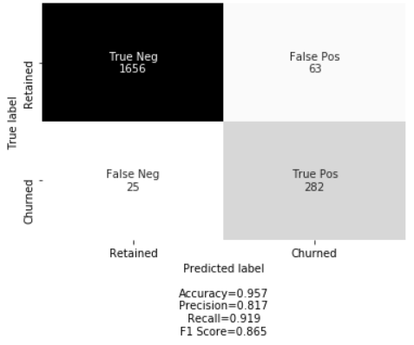
Top Performing Algorithm - Metrics

Slide 17
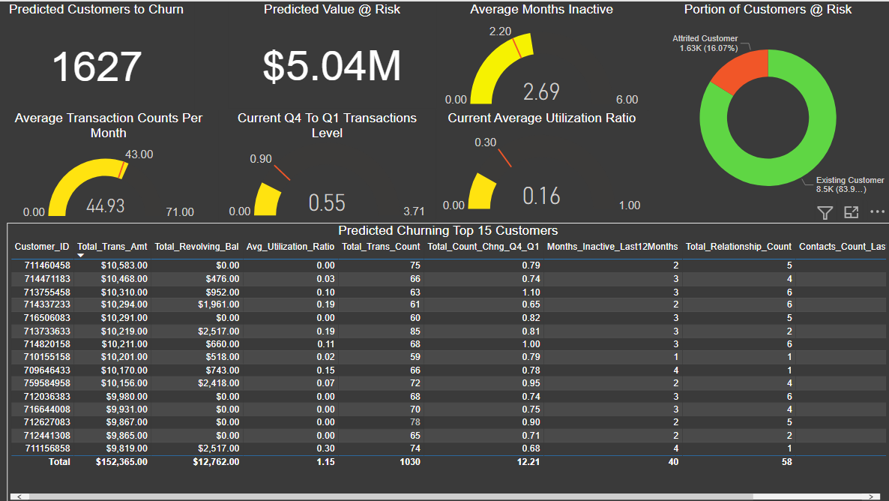
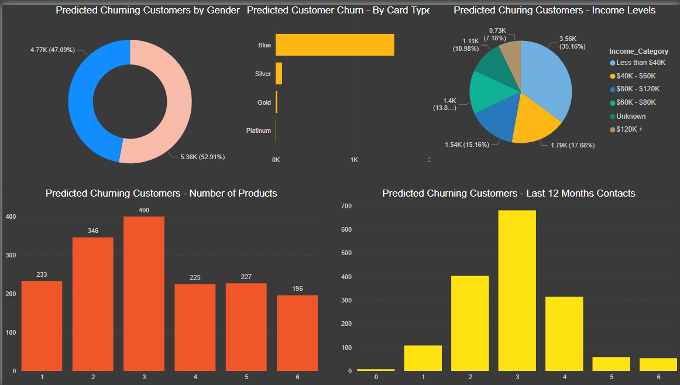
Dashboards to track Indicators & Key Factors

Slide 18
AGENDA
01
02
03
04
Project Background
Client Introduction and Problem Statement
Business Problem Definition
Business question v.s. Data questions
Project Process & Approach
How work process
Values delivery
EDA, Modelling, & Testing
Next steps and Summary
05
Future improvements

Slide 19
Future work
Feature Engineering:
Running optimization and hyperparameter tuning
Introduce New Features such as signals / indicators
Run PCA and Reverse Feature Elimination or Backward selection to select the best features
Ensemble Learning and Soft Voting:
Combine the predictions of all these classifiers to see if we get better predictive performance compared to each constituent individual classifier.

Slide 20
Thank you & Questions

